Slide 1
Visualization on Heart Disease Targets
Projection of Data on Heart Disease to the checkup team in cardiology department

Slide 2
Projection of Data on Heart Disease to the checkup team in cardiology department
Healthcare Data on Heart Disease:
Data has been taken from: https://www.kaggle.com/ronitf/heart-disease-uci
Visualizations on various features of the data to the Checkup team who are most likely targets of heart disease.

Slide 3
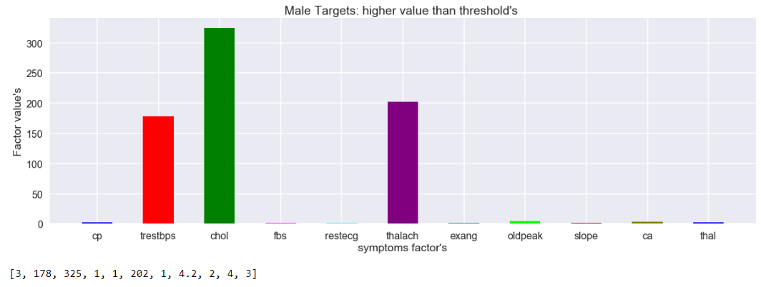
Graphs on male individuals potentially target for heart diseases

Slide 4
Characteristics obtained from the graph in male individuals who are targets of heart disease
cholesterol levels are above 300 for male and max is upto 325
restbprs max is 178
thalach is seen up to max 202
cp and thal are 3
fbs, restecg, and exeng are 1
oldpeack is 4.2
ca is recorded max to 4
slope is 2

Slide 5
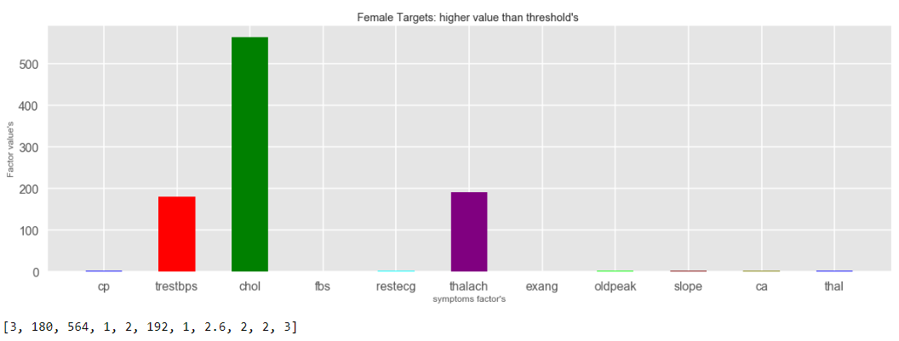
Graphs on male individuals potentially target for heart diseases

Slide 6
Characteristics obtained from the graph in female individuals who are targets of heart disease
cholesterol levels are above 500 for female and max is upto 564
restbprs max is 180
thalach is seen up to max 192
cp and thal are 3
fbs and exeng are 1
ca, restecg, slope are recorded 2. ca is less than male here.
oldpeak is 2.6 which is lesser compared to men.

Slide 7
Inferences from the male/female data points on heart disease.
Individuals coming for the checkups having trestbps>170 have likely chances to have high cholestrol
If cholesterol in male is more than 300 and in female it is more than 500 are highly potential targets for Heart disease.
Step 1
Male (trestbps>170)
Female (trestbps>170)
Step 2
Chol>300
Chol>500
Step 3
Heart disease targets
Heart disease targets

Slide 8

Thank You
Trishala Basti ( Student of ELU)
Module2 Project

